Slide 1

Sparse and Redundant Representations and Their Applications in
Signal and Image Processing (236862)
Section 5: Theoretical Study of the Approximate Pursuit Problem
Winter Semester, 2018/2019
Michael (Miki) Elad

Slide 2
Meeting Plan
Quick review of the material covered
Answering questions from the students and getting their feedback
Addressing issues raised by other learners
Discussing a new material – Dantzig Selector & Near-Oracle performance
Administrative issues

Slide 3
Overview of the Material
Analyzing the Approximate Pursuit Problem
Uniqueness vs. Stability – Gaining Intuition
The Restricted Isometry Property (RIP)
Key Properties of the Restricted Isometry Property (RIP)
Theoretical Study of P₀^{ε} in the Noisy Case
Performance of Pursuit Algorithms – General
Basis-Pursuit Stability Guarantee
Thresholding Stability Guarantee: Worst-Case
OMP Stability Guarantee
Rate of Decay of the Residual in Greedy Methods
Course Summary and a Glimpse to the Future
Course Summary & A Glimpse to the Future

Slide 4
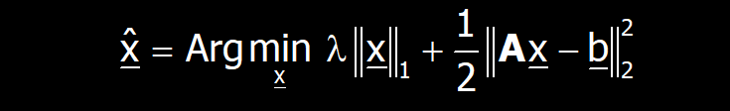
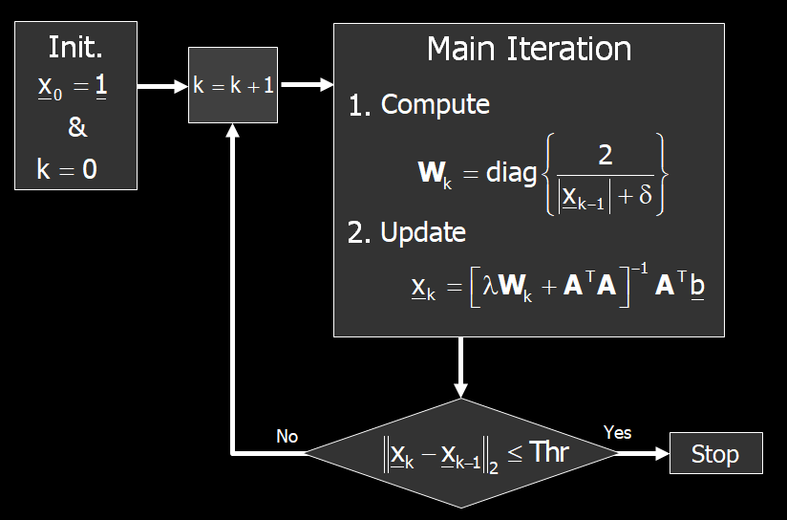
Issues Raised by Other Learners
Bisection strategy in IRLS Solution of the Basis Pursuit
In the video "IRLS Solution of the Basis Pursuit", at the time slice 5:49, the bisection strategy is mentioned to improve the effectiveness of the searching. Could you please put some more words to explain how this trick is so helpful?
1
2
ε
3
4
λ

Slide 5

Your Questions and Feedback

Slide 6
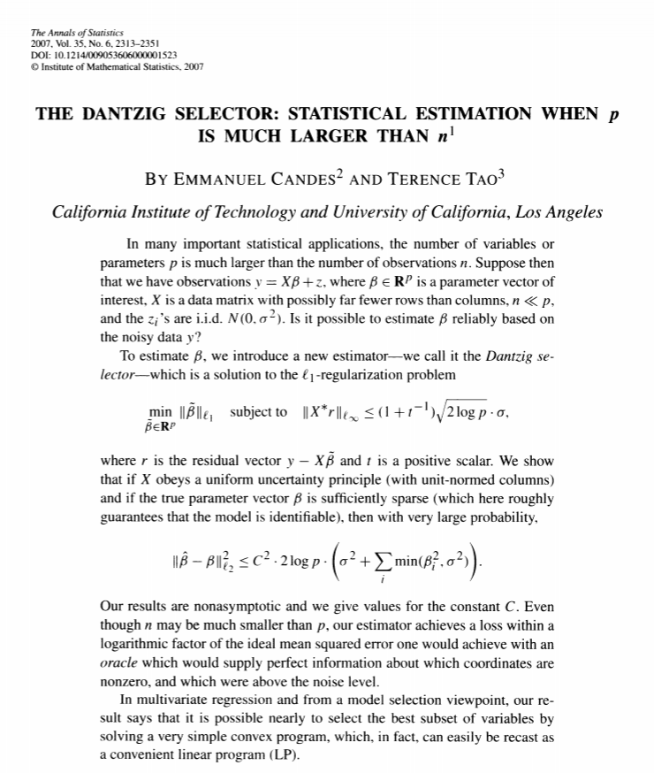
New Material?
The Dantzig Selector (DS)
This is a new pursuit algorithm
It was proposed in 2007 by Candes and Tao, and termed Dantzig-Selector (DS)
The name chosen pays tribute to George Dantzig, the father of the simplex algorithm that solves Linear Programming (LP) problems
The connection to LP will become evident shortly

Slide 7
The DS: Introduction
We already met various approximation algorithms for solving the above task
One natural option we had is the Basis-Pursuit:
We present now an appealing and surprising alternative pursuit algorithm for sparse approximation: The Dantsig-Selector
This algorithm is competitive with all the algorithms we have met, and it has few interesting advantages

Slide 8
The DS: Intuition
The original L₂ constraint speaks in terms of the noise power, but says nothing about the noise shape. Does the residual behave like random Gaussian noise?
The DS computes the residual and forces it to be nearly uncorrelated with the atoms in A. This is formulated by the L∞ - the maximal inner product must be below some threshold
Intuition: If we look at the residual r=Ax-b and recognize shapes of atoms, it means that we have not peeled all the true content from the noise

Slide 9
The DS as Linear Programming

Slide 10
The DS: The Unitary Case
λσ
This is a classic soft-shrinkage, just like the one we get for the Basis Pursuit in the unitary case
In the unitary case BP=DS

Slide 11
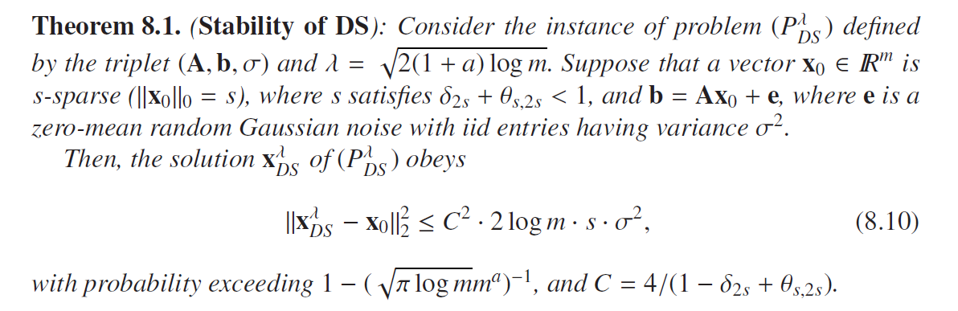
The DS: Theoretical Guarantee
Random noise (not adversarial)
Near-Oracle Performance
ROP
RIP

Slide 12
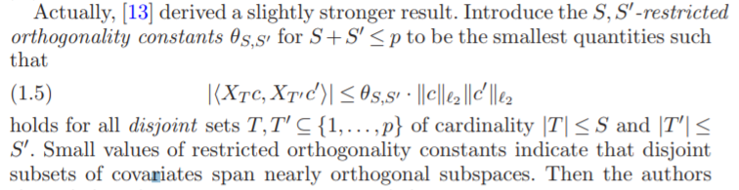
The DS: Theoretical Guarantee
ROP ?

Slide 13
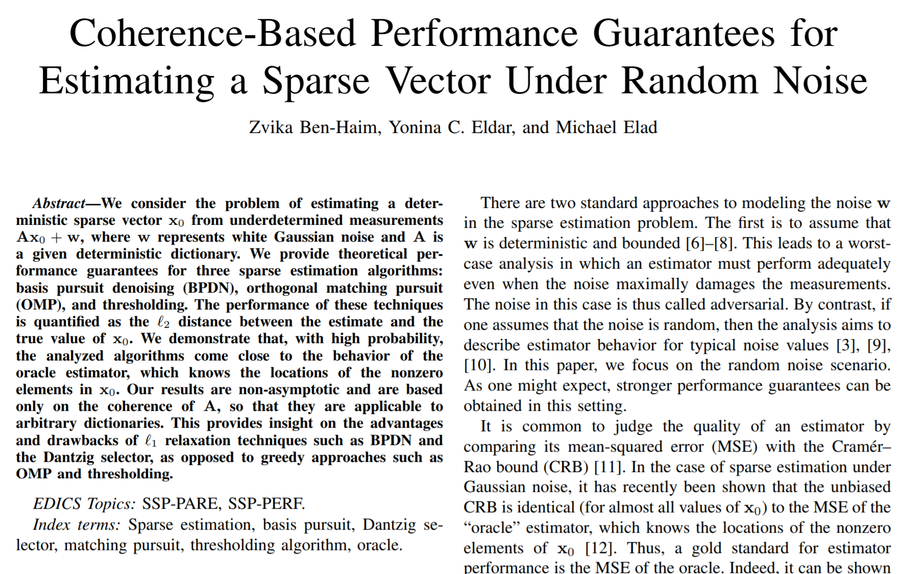
Near Oracle Performance ?
Could we get similar “near-oracle” performance guarantees for the OMP or Basis-Pursuit?
The answer is positive, and there are many papers offering such an analysis
Obviously, the key is to assume random noise instead of adversarial one … and rely on proba- -bilistic inequalities
We present one such paper from 2010

Slide 14
Near Oracle Performance ?

Slide 15
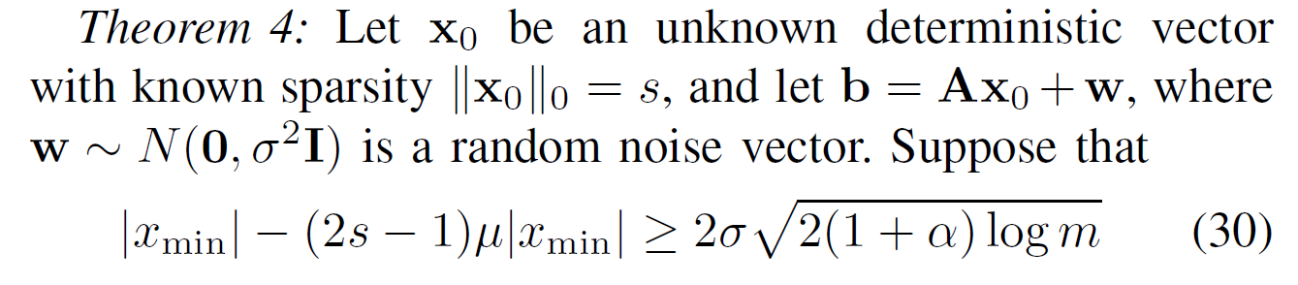
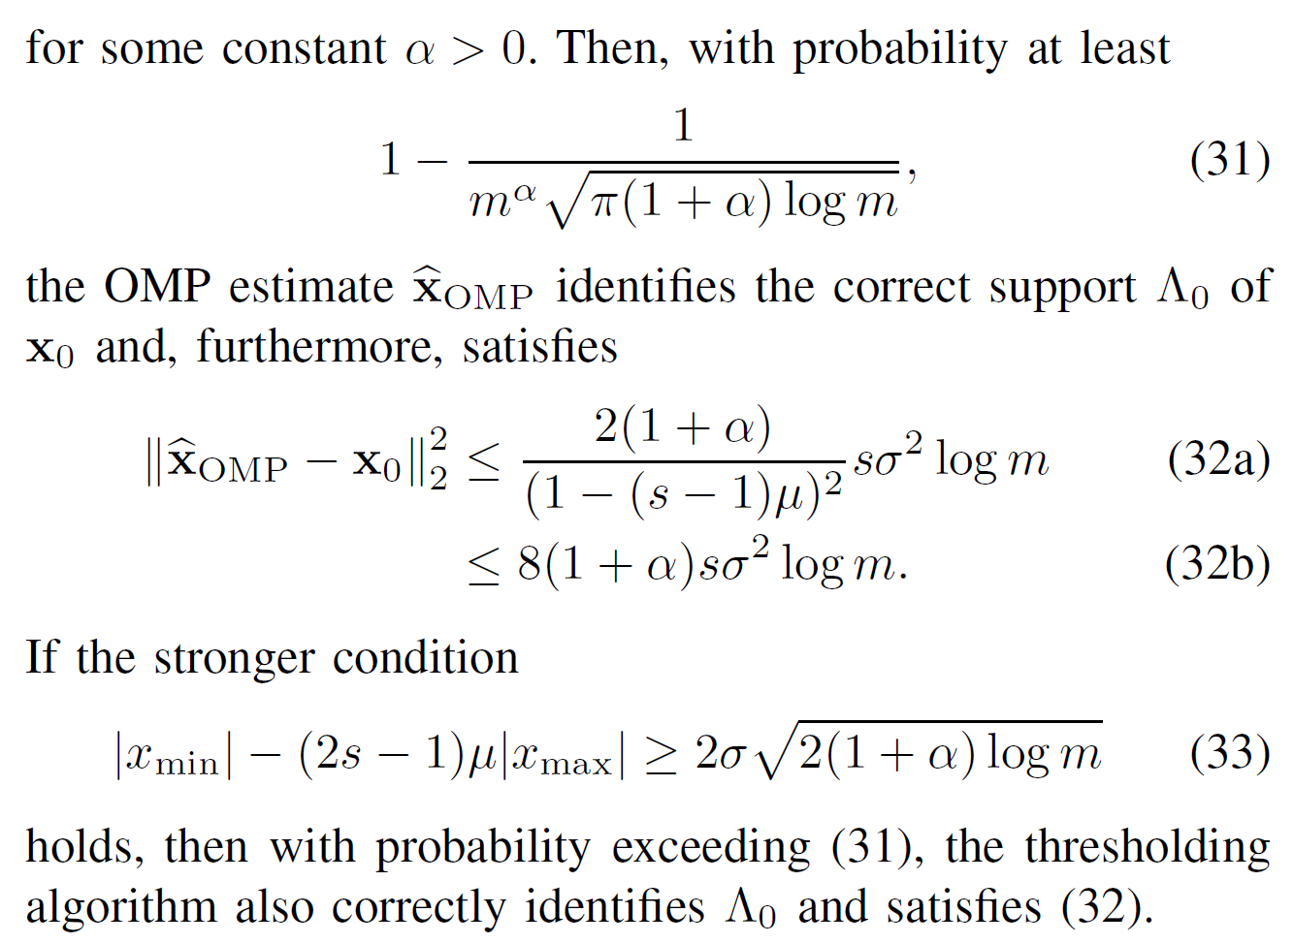
A Sample from This Paper’s Results
s - cardinality
m – number of atoms
α - a parameter (>0) to choose
Where is this coming from?
This is the oracle performance. Why does it look so different from things we have seen?
Is this a familiar condition?

Slide 16
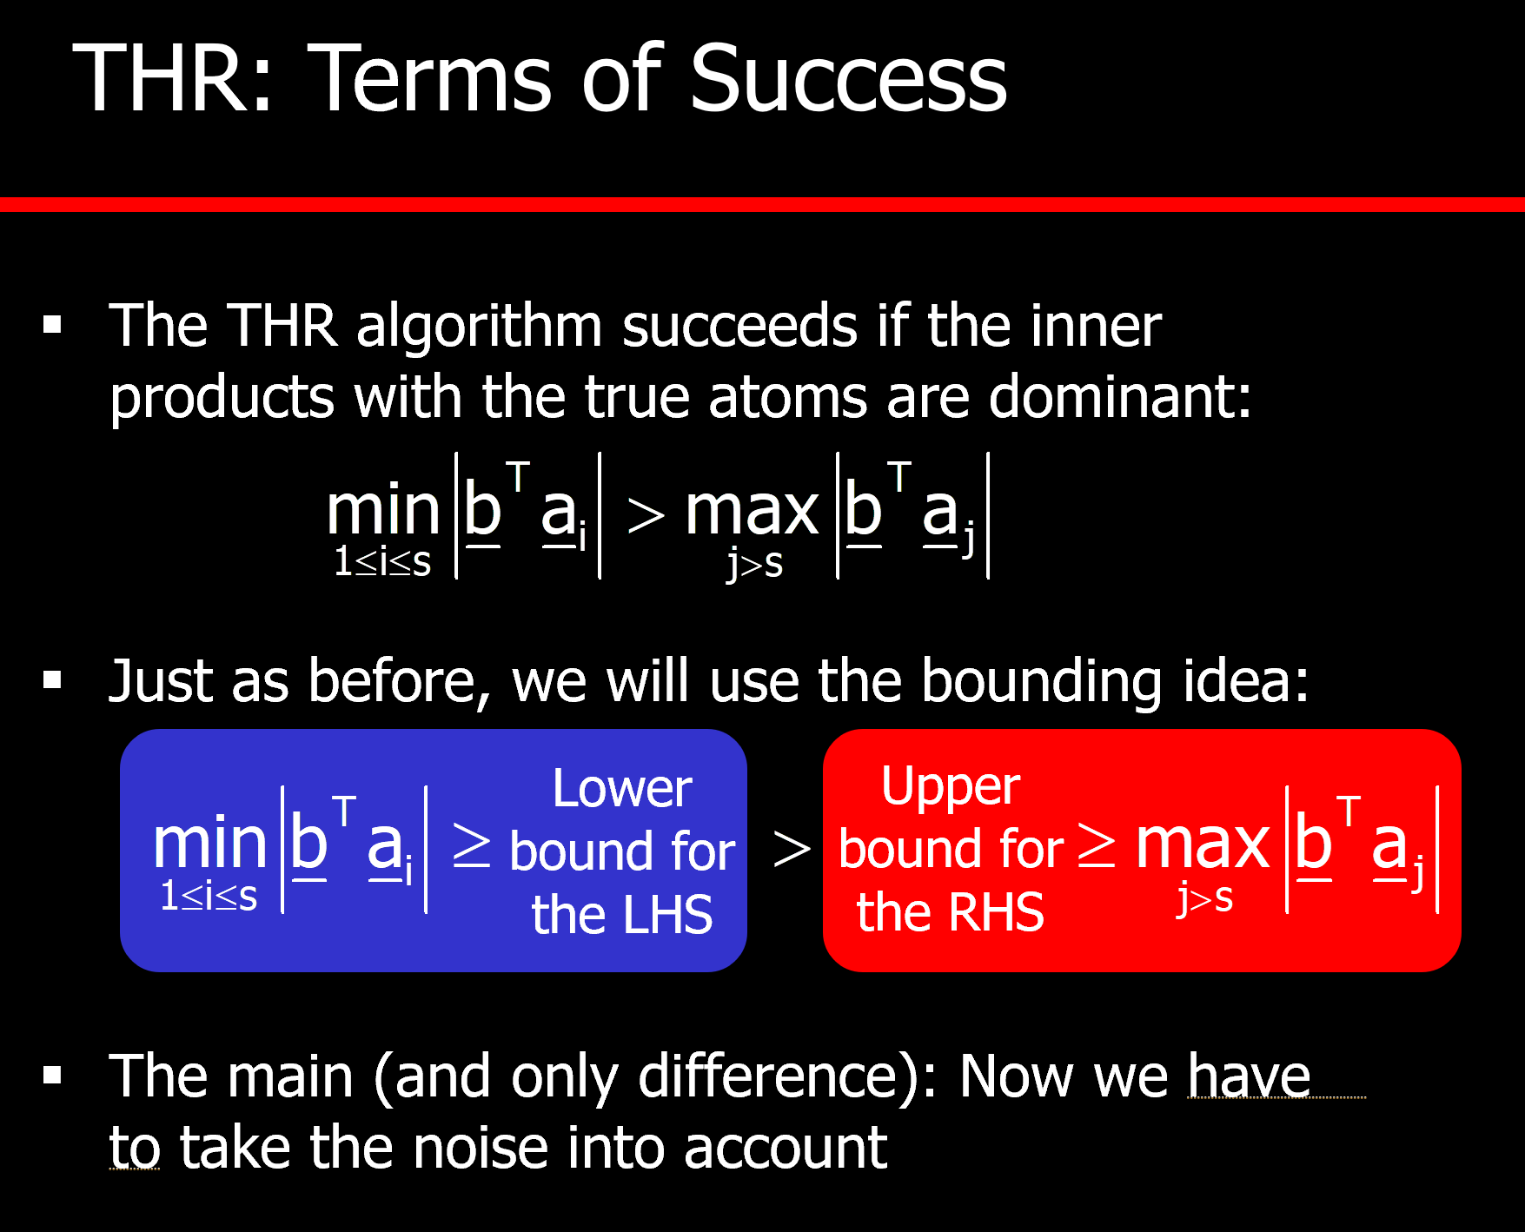
Zoom In (1): Probability of Success

Slide 17
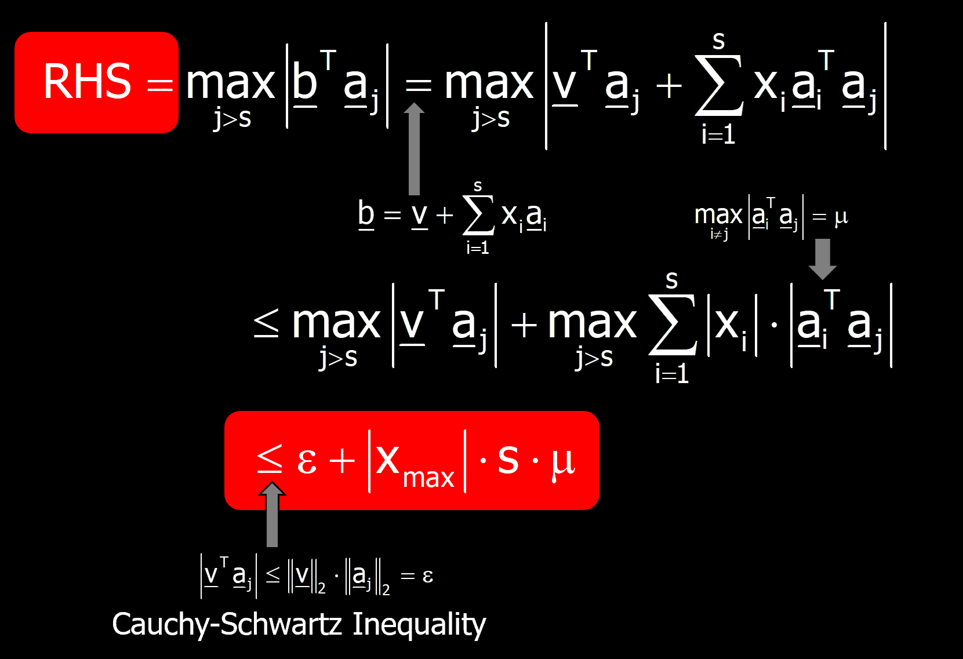
Zoom In (1): Probability of Success

Slide 18
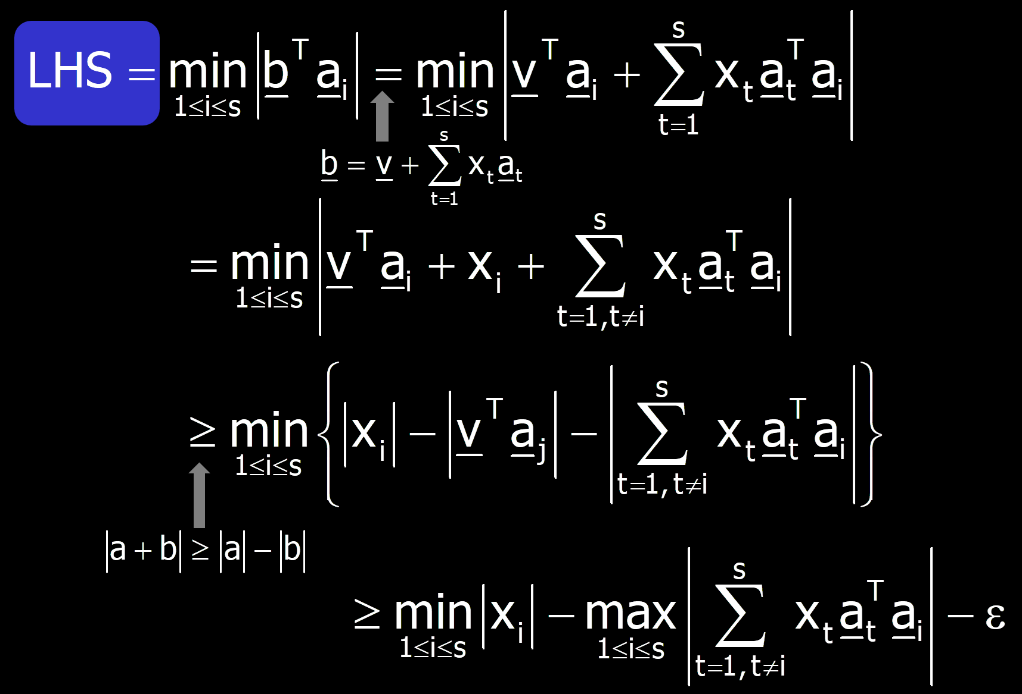
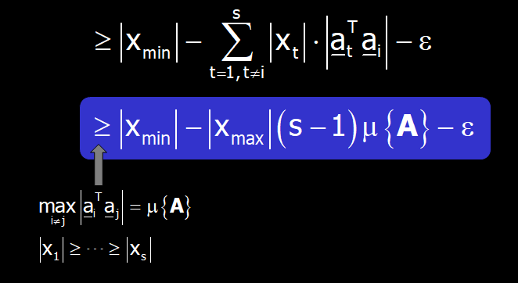
Zoom In (1): Probability of Success

Slide 19
Zoom In (1): The Condition
Gathering the two parts, our worst-case analysis gives:
What is different as we move to the Gaussian noise? The noise term max_{k}|w^{T}a_{k}| cannot be bounded by ε anymore
Instead, we set an arbitrary threshold, τ, and bound (from bellow) the probability for the event to be true:
We choose for reasons that we become clear later

Slide 20
Zoom In (2): Probability of Success
Sidak’s Lemma
These are Gaussian RV’s with zero mean and σ as their STD

Slide 21
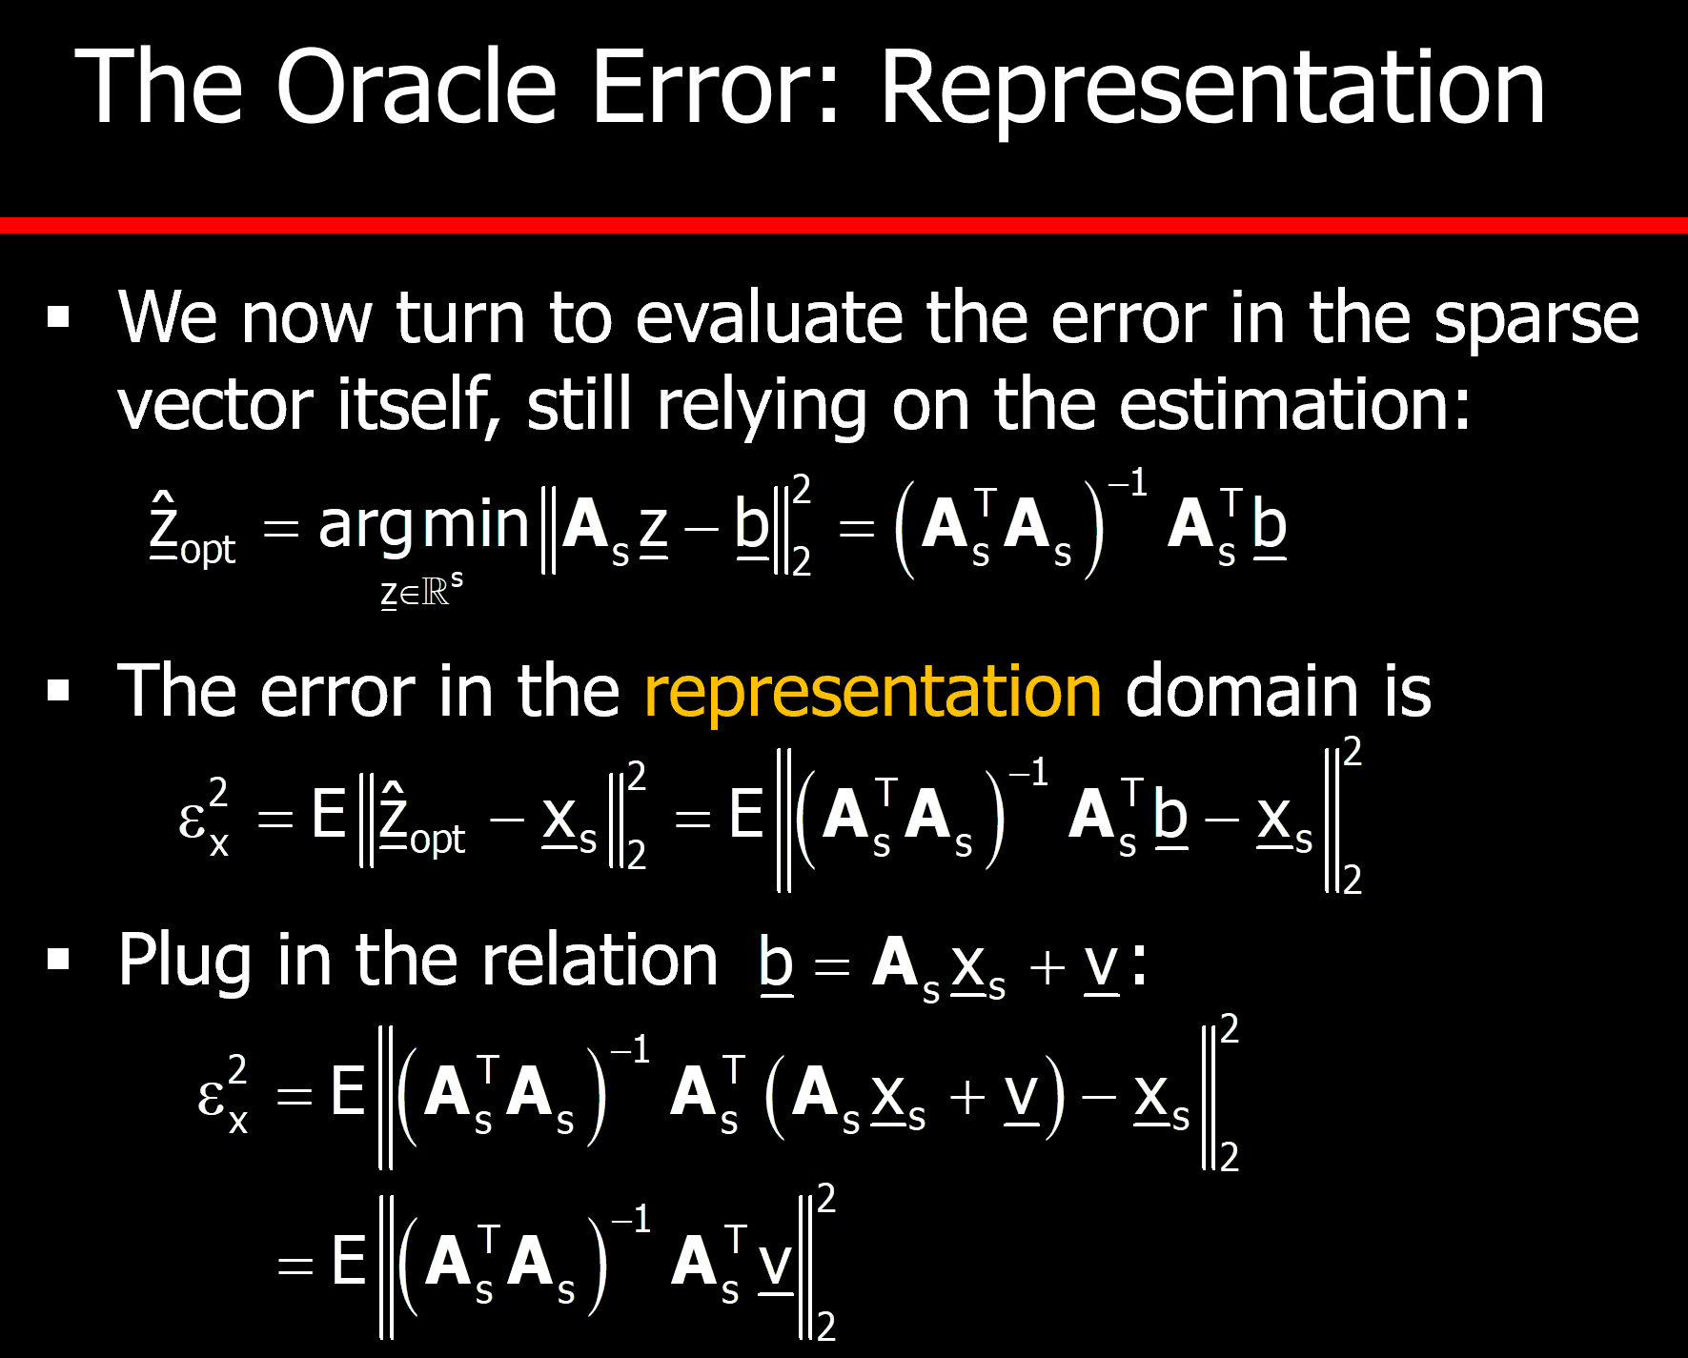
Zoom In (3): Oracle Performance

Slide 22
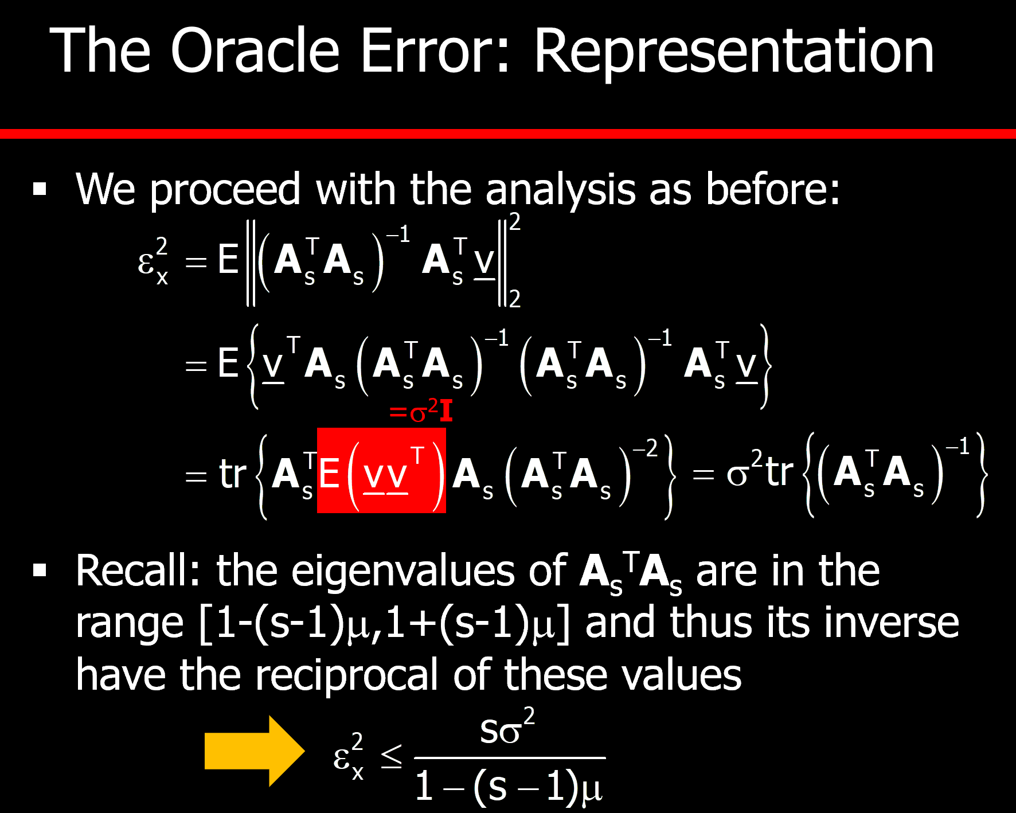
Zoom In (3): Oracle Performance
?

Slide 23
Zoom In (3): Oracle Performance
We will NOT work with expectations:
and now invoke these:
1.
2.
This is a random event with probability as derived above

Slide 24
Administrative Issues
The final project in Course 1 is due on December 16th
Moving to the Second Course:
We meet again on 20/12 to resume the course with the second half
Please arrive that day after doing Section 1 of Course 2
Your Research-Project Assignment ….

Slide 25

